Slide 1

EXPLORING COLLEGE PLACEMENT TRENDS
CAPSTONE PROJECT
Presented By:
Vikash Meena
Technocrats Institute of Technology
Department of CSE- Data Science

Slide 2
Outline
Problem Statement (Should not include solution)
Algorithm
Result
Conclusion
Future Scope(Optional)
References

Slide 3
Problem Statement
Analyzing College Placement Data: Given a dataset containing information about students, including their names, majors, and the companies they were placed in after college, the objective is to gain insights into the distribution of placements across different branches (majors) and companies.

Slide 4
Algorithm & Deployment
Dictionaries used:
numpy
Pandas
Attributes Used:
Dataframe
Sorting
Chart

Slide 5
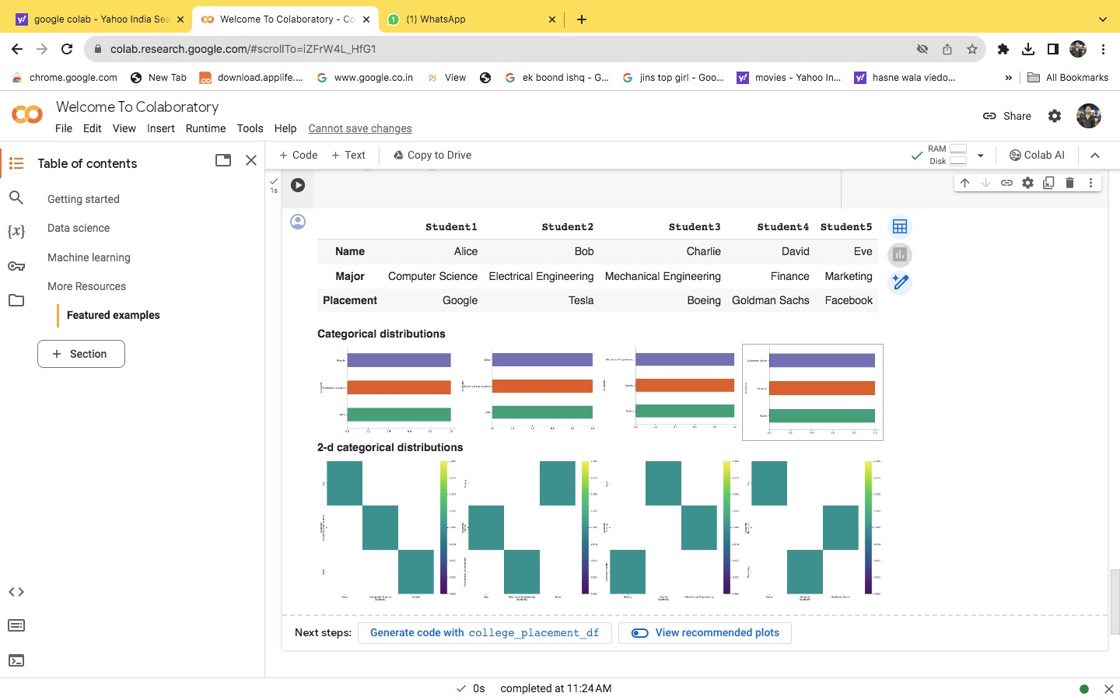
Result

Slide 6
Conclusion
After analyzing the college placement dataset, several key insights have been uncovered:
Distribution of placements
Popular majors
Top Employers
Trends in job markets

Slide 7
References
Dataset:
Kaggle website for dataset
Coding Platform:
Google colab
Python app 3.12

Slide 8
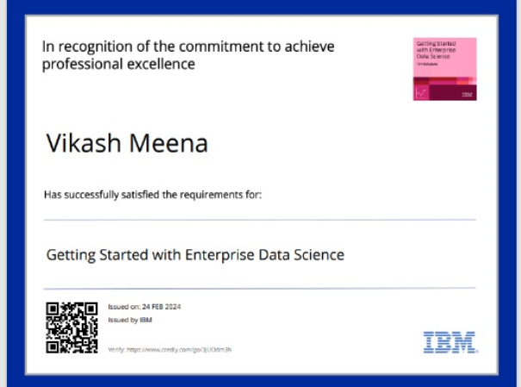
course certificate 1

Slide 9
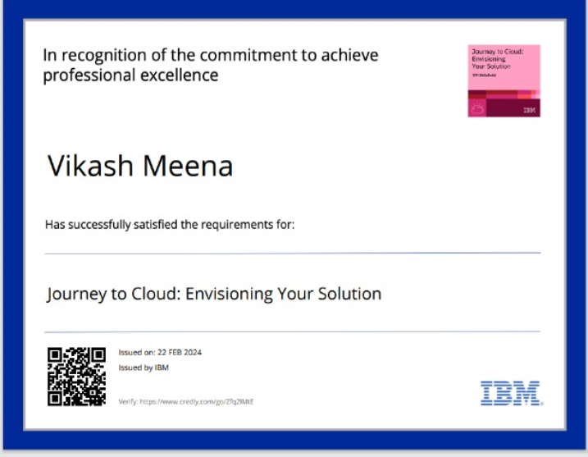
course certificate 2

Slide 10


